Slide 1
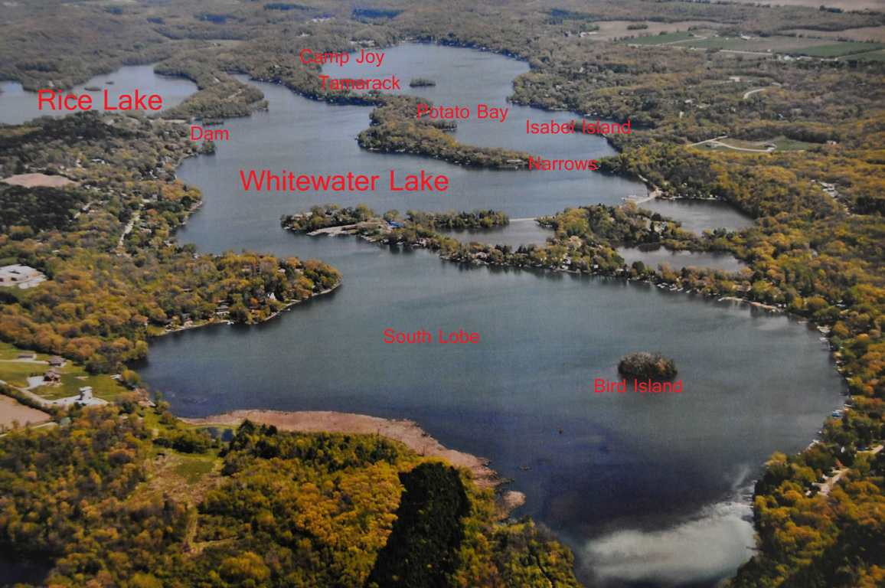
Whitewater-Rice Lakes Management District
2024 Annual Membership Meeting
August 24, 2024
&
GWLPOA Update

Slide 2
Agenda
9:00 Opening remarks – Carol Ducommun, Chair
Call to Order & Introductions
Approve 2023 Annual Meeting Minutes
9:05 Review by commissioners:
Chemical & Barley Initiative – Mike Lindenmuth
Weed Harvesting – Carol Ducommun
Bog Removal - Rich Charts
Equipment - Chuck Chamberlain
Purchase Land & Building – Carol Ducommun
Financials – 2024 Actuals – Dan Berg
2025 Capital Plan – Chuck Chamberlain
2025 Proposed Budget – Dan Berg
Financial Review – Don Olinger
10:15 Comments by Sheriff Dave Gerber
10:20 Introduction of Candidates & Voting
10:25 Presentations on Lake Initiatives
Wildlife Management – Ernie Roy
Fish Management – Tom Potrykus
Safety – Larry Brady/Amy Rodgers
Wakes & Shoreline Erosion – Jeff Panek
Shoreland Management – Brian Rahmander
10:35 Proposed Bylaw Amendments – Carol Ducommun
10:45 Five-minute break
10:50 GWLPOA Annual Meeting – Nancy Lindenmuth
11:05 Election results
11:05 Honor Outgoing Board Member: Rich Charts
11:10 Input from Towns of Richmond and Whitewater
11:10 Introduction of Candidates followed by voting
11:15 Open Discussion/Resident Input
11:30 Adjournment
11:30 Brief LMD Meeting

Slide 3
Overview
Excellent harvesting crew
New 7’ harvester delivered for Rice Lake
Good conditions
Clarity, oxygen levels → no problematic changes from 2023
Strong leadership team
Continued work on initiatives
Equipment storage
Barley Straw experiment for algae
Navigator teams
Will successfully meet 2024 financial goals
Carol Ducommun

Slide 4
Herbicide
Map of areas treated
Annual treatment process and timeline
Barley Straw Project
Mike Lindenmuth

Slide 5
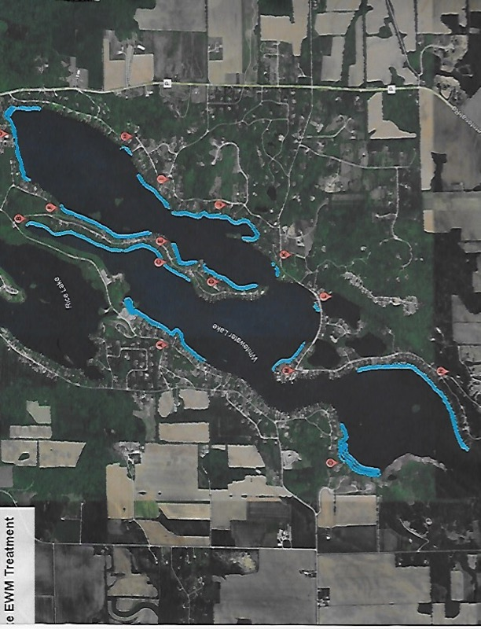
2024 Herbicide Treatment

Slide 6
Barley Straw Project
Project funded by Lake Management District with approval/oversight from Wisconsin DNR
As barley straw decomposes it releases natural chemical that inhibits algae growth
No known toxic effects on:
- rooted aquatic plants - zooplankton
- insect larvae - fish
Potential cost-effective, environmentally-acceptable method to control algae in ponds and lakes
Water samples analyzed by Madison testing lab
Mike Lindenmuth

Slide 7
Barley Straw Bag
Mike Lindenmuth

Slide 8
Barley Straw Bags
Mike Lindenmuth

Slide 9
Barley Straw Pilot Placements
#2
#3
#1
#1 and #2 Are Treated Areas
#3 is the Control Area
Mike Lindenmuth

Slide 10
Weed Harvesting
Excellent, highly skilled team
Great communication
Prep, launch and maintain equipment
Attended 2024 Aquarius safety training seminar
Operate four days per week with Monday weed pickups
Light year after initial cleanup in June
Priorities:
Retaining crew members
Permanent equipment storage
Mechanical harvesting vs. chemical treatment
Carol Ducommun

Slide 11
Bog Harvesting
First bog appeared in mid-June, two weeks ahead of 2023
Other bogs began rising in August
Awarded second, ten-year DNR permit in April
For “approximately … 10,000 cu. yd.” of bog material over 10 years
Permit ends 4/17/2034
Riese Aquatics awarded contract for Fall 2024
Roughly 8 days (~ 1,000 cu. yds.) per 2024 revised budget
Rich Charts

Slide 12
Equipment Update
New 7’ harvester & trailer delivered early
$134,950 (50%) award from Wisconsin Waterways Commission
Future equipment purchases outlined in 5-Year Capital Plan
Chuck Chamberlain

Slide 13
Land Acquisition (Aug. 2023 slide)
Strategically important for Lake Management District
Preservation of equipment ($2 Million+ replacement value)
Home base for operations: tool storage, maintenance, power washing
Year-to-year continuity
Not subject to rising rental rates
Board able to focus on other priorities
Implementation Plan:
Buy 2+ acres with/for pole barn (60x100 minimum)
Relatively flat land, relatively close to lake
Pursuing leads, contacting landowners
Financing available from First Citizens
Carol Ducommun and Chuck Chamberlain

Slide 14
Land Acquisition
August 2023:
Unanimous approval to acquire land & building for storing District equipment not to exceed total of $450,000, to be financed with debt
20 yr. amortization - limit for municipalities (two 10-year loans)
First Citizens State Bank: best municipal rate (20% discount)
Fin costs $30,277 per yr., 20% down; will not increase tax assessment
August 2024:
Seeking approval to incur debt up to $450,000 for land & building
Assuming 30% downpayment – up to $135,000
20-year amortization – likely four, five-year loans
Est. $25,500/yr. prin+interest @4.8% after discount
Carol Ducommun and Dan Berg

Slide 15
Land Acquisition
Sent letters to land-owners around lake area
Identified using Walworth County GIS system
Investigated “any and all” viable options including:
Giese Property (N8885 Cty. P)
Bembenek property (R&W Townline Road & Brown Rd.)
State of WI farm property (W7789 Kettle Moraine Drive)
City of Whitewater Industrial Park properties
Other land parcels in and around LMD & City
Continued conversations with First Citizens
State Bank
Carol Ducommun and Dan Berg

Slide 16
2024 Financial Statement

Slide 17
Five Year Capital Plan
 | 2023 | 2024 | 2025 | 2026 | 2027 | 2028 | 2029
Opening Balance | $136,484 | $169,309 | $171,011 | $96,261 | $69,261 | $42,261 | $102,761
Budgeted Contribution | $120,000 | $60,000 | $60,000 | $60,000 | $60,000 | $60,000 | $60,000
Grants Received | $67,475 | $67,475 |  | $87,500 | $87,500
GWLPOA Donation | $2,000
Proceeds sale capital equip. | $7,000
Interest | $545 | $350 | $250 | $500 | $500 | $500 | $500
7' Harvester ($269,900) | $(134,950) | $(134,950)
New harvester ($350,000) |  |  |  | $ (175,000) | $(175,000)
Capitalized expenses | $(1,745) | $(2,144)
Tool Trailer | $(5,000)
Transport Barge Repairs |  | $(11,529)
Loan to operating fund | $(22,500) | $22,500
Down payment land/bldg. |  |  | $(135,000)
Ending Balance | $169,309 | $171,011 | $96,261 | $69,261 | $42,261 | $102,761 | $163,261

Slide 18
2025 Budget

Slide 19
Financial Examination Report
​
Financial review conducted by Don Olinger (examiner since 2020)
Performed verification of tax receipts and operational and capital disbursements
All tax assessments received as budgeted/approved by the electors
97% of expenses validated for proper approval, documentation and purpose
District’s revenues and expenses for 2023 are accurately reflected in the information provided to electors for the 2024 Annual Meeting
Don Olinger

Slide 20
Comments by Sheriff Dave Gerber

Slide 21
Introduction of Candidates
Carol Ducommun
Incumbent running for 3-year term
Bob Szcinski
Running for open 3-year term

Slide 22
Wildlife Management
Successful goose round up this year
Volunteers helped the Dept. of Agriculture collect 53 geese from Whitewater Lake
Gratefully thank volunteers for the mitigation and removal of these disease carrying birds
Ernie Roy

Slide 23
Fish Management
Fish stocking
Fish crib construction
Carp removal
Tom Potrykus

Slide 24
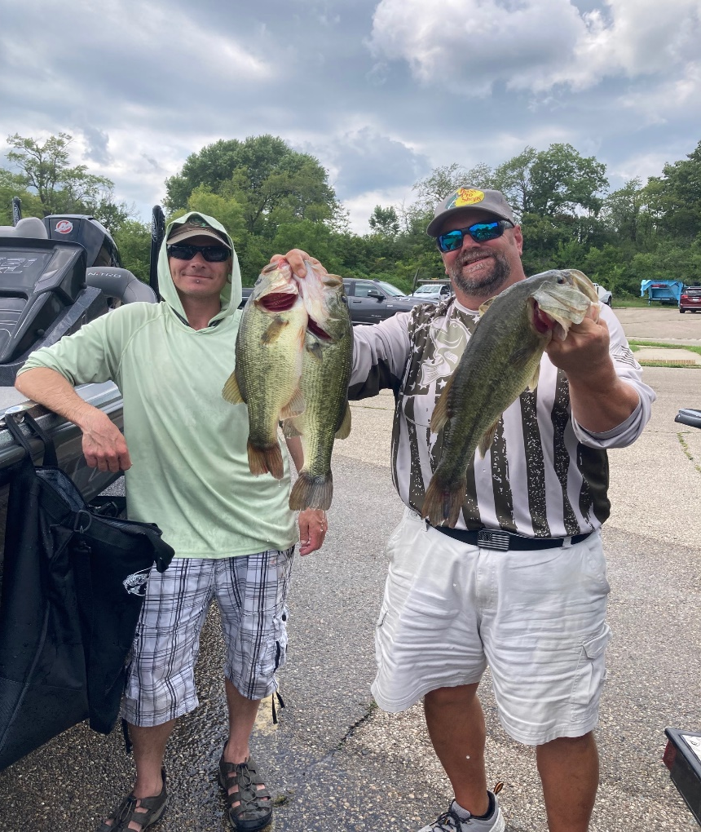
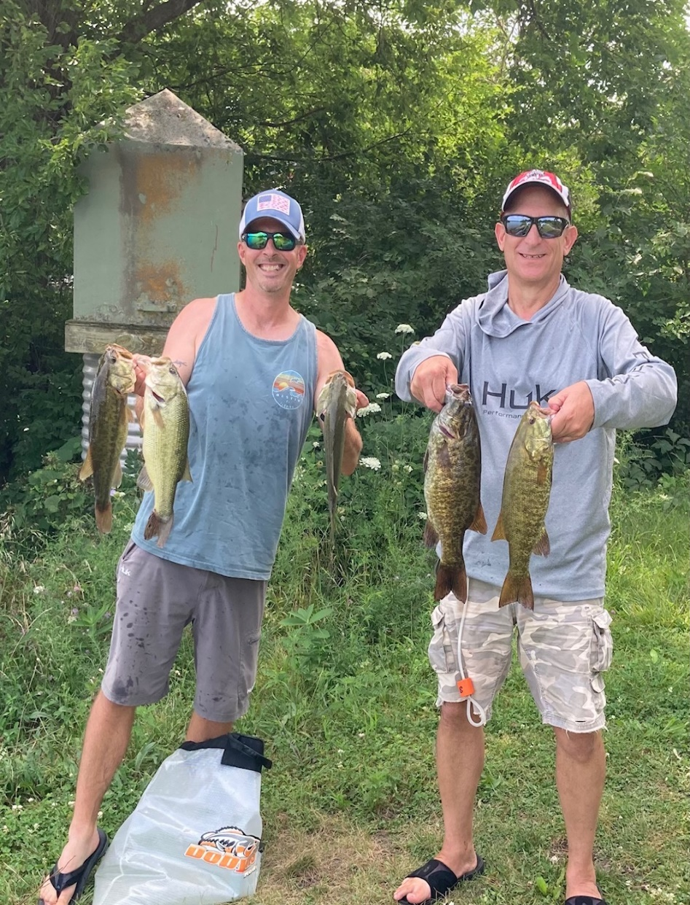

Slide 25
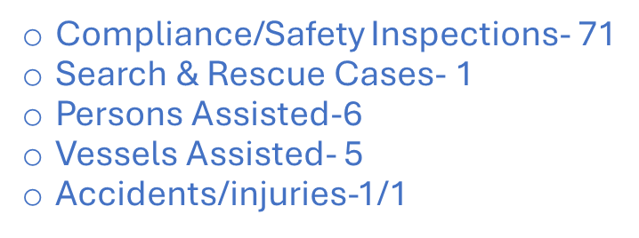
Safety Team Report Stats as of 7/30/24
Boater Safety Classes - 45 Students in two 2024 boater safety classes held at the lake
Team of 5 Water Patrol Officers = more hours on the water vs last summer (251.5 YTD)
Relatively safe Summer Season - No fatalities / no near drownings
On the water:
# of warnings - 68
# of citations - 12
Top 5 issues:
Slow No Wake violations
Wearable PFDs
Navigation Rules
Mandatory PFD Wear
Careless/Reckless Operation
Larry Brady / Amy Rodgers / Jake Hintz

Slide 26
Boat Manager
Deputy Jake Hintz

Slide 27
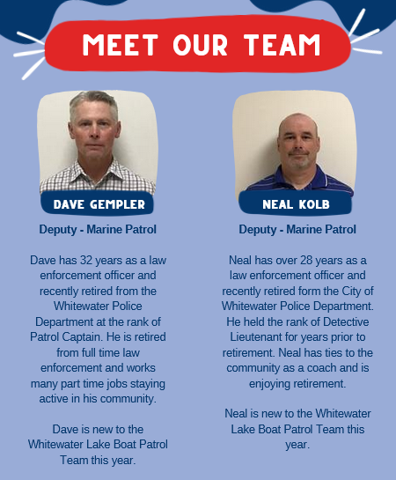

Slide 28
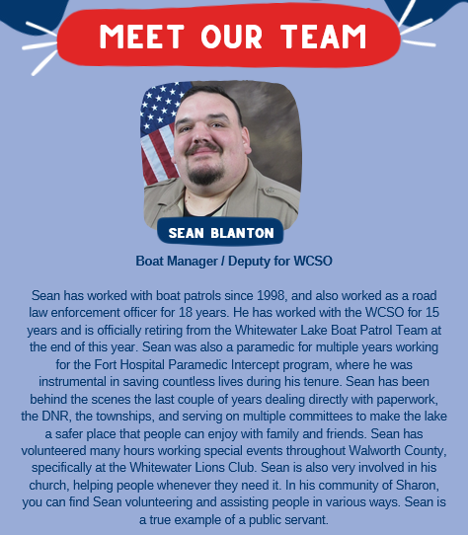
Thank you Sean for your service!

Slide 29
Navigator Team - Wakes and Shoreline Erosion
Two WI watersport bills considered last session; next session begins Jan ‘25
SB1016 no enhanced wakes for
any lake under 1500 acres or with max depth less than 20’
within 700’ of shore or anyone using the lake
SB680/AB656 no wakesports within 200’ of shore & lakes 50 acres or less
WI DNR survey April 2024: 2/3 favor regulating wakes/ballast systems
FOX 6 investigative report: Wakesurfing boats on WI lakes
Reconvened WRLMD Wakes Team to:
review Own Your Wake campaign “effectiveness”
develop follow-on survey for members
Local concerns: social media posts, lake activities, Rice Lake
Jeff Panek

Slide 30
Shoreland Management
For questions & suggestions regarding:
Lawncare
Shoreline gardens
Invasive Species
Exterior lighting
DNR/County permitting requirements
Shoreline management practices greatly impact water quality
Resources:
Wisconsin DNR
Walworth County
Healthy Lakes & Rivers
Whitewater-Rice Lake Management District
Wild Ones Kettle Moraine Chapter
Geneva Lakes Conservancy
Brian Rahmander

Slide 31
Proposed District Bylaw Amendments
Conform to current Wisconsin Statutes (Ch 33 and Ch 6)
All electors & real property owners can vote
Able to send email notices if members agree
Add agenda items 30 days prior w petition, delete “as the board may determine”
Board members or their family may conduct business with District
Other amendments:
Clarify that District does not own nor control Rice Lake Dam
Change “audit” to “independent financial review”
Correct spelling errors
Carol Ducommun

Slide 32
GWLPOA Meeting
Greater Whitewater Lake Property Owners Association
"Connecting and Strengthening our Lake Community
through Communication and Social Gatherings"

Slide 33
Greater Whitewater Lake Property Owners Association
Annual Meeting Agenda 8/24/2024
Call to Order
Motion to approve annual minutes of August 26, 2023
Motion to approve 2024 Balance Sheet
President’s Report
Business
Motion to accept 2024-2025 GWLPOA Board members
Questions
Motion to adjourn
Nancy Lindenmuth

Slide 34
GWLPOA Treasurer’s Report 1/1/2024 – 7/31/2024
Nancy Lindenmuth

Slide 35
Greater Whitewater Lake Property Owners Association
GWLPOA 2024 Events
• April 20 - CPR/First Aid Class
• April 27 - Directory pick up
• May 18 - Welcome Back Kick Off Event
• May 30 - Pontoon Party on WW Lake
• June 8 - Lake Neighbors Happy Hour
• June 15 - Music on the Lake on WW Lake
• June 20 - Pontoon Party on WW Lake
• June 22 - Hot Dog Picnic
• June 22 - Music on the Lake on WW Lake
• June 29 - Pontoon Party on Rice Lake
• July 18 - Pontoon Party on WW Lake
• July 20 - Music on the Lake on WW Lake
• August 3 - Lake Neighbors Happy Hour
• August 15 - Pontoon Party on WW Lake
• August 17 - Golf Outing & Dinner
• August 23 - Lake Neighbors Happy Hour
• August 24 - Annual Meetings for LMD & GWLPOA
• September 1 – Music on the Lake on WW Lake
• September 7 – Music on the Lake on WW Lake
• September 14 - End of Summer Dinner & Trivia Event
• September 19 - Pontoon Party on WW Lake
Nancy Lindenmuth

Slide 36
Greater Whitewater Lake Property Owners Association
GWLPOA 2024-2025 Board
Nancy Lindenmuth - President
Lillian Roy – Past President
Eileen Burke
Linda Meyer
Amy Rodgers
Bernie Labovitch
Janet Hersh
Lynne Bishop
Betsy Zande
Kristina Czarnecki
Annette Anderson
Lori Rothstein
Melanie Harris
"Connecting and Strengthening our Lake Community
through Communication and Social Gatherings"
Nancy Lindenmuth

Slide 37
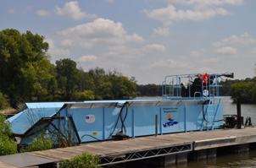
Whitewater-Rice Lakes Management District
2024 Annual Membership Meeting Continues

Slide 38
Whitewater-Rice Lakes Management District Agenda (Continued)
Election Results
Honor outgoing Board Member Rich Charts
Input from Town of Whitewater
Open Discussion/Resident Input
Adjournment: Next meeting August 23, 2025

